Slide 1
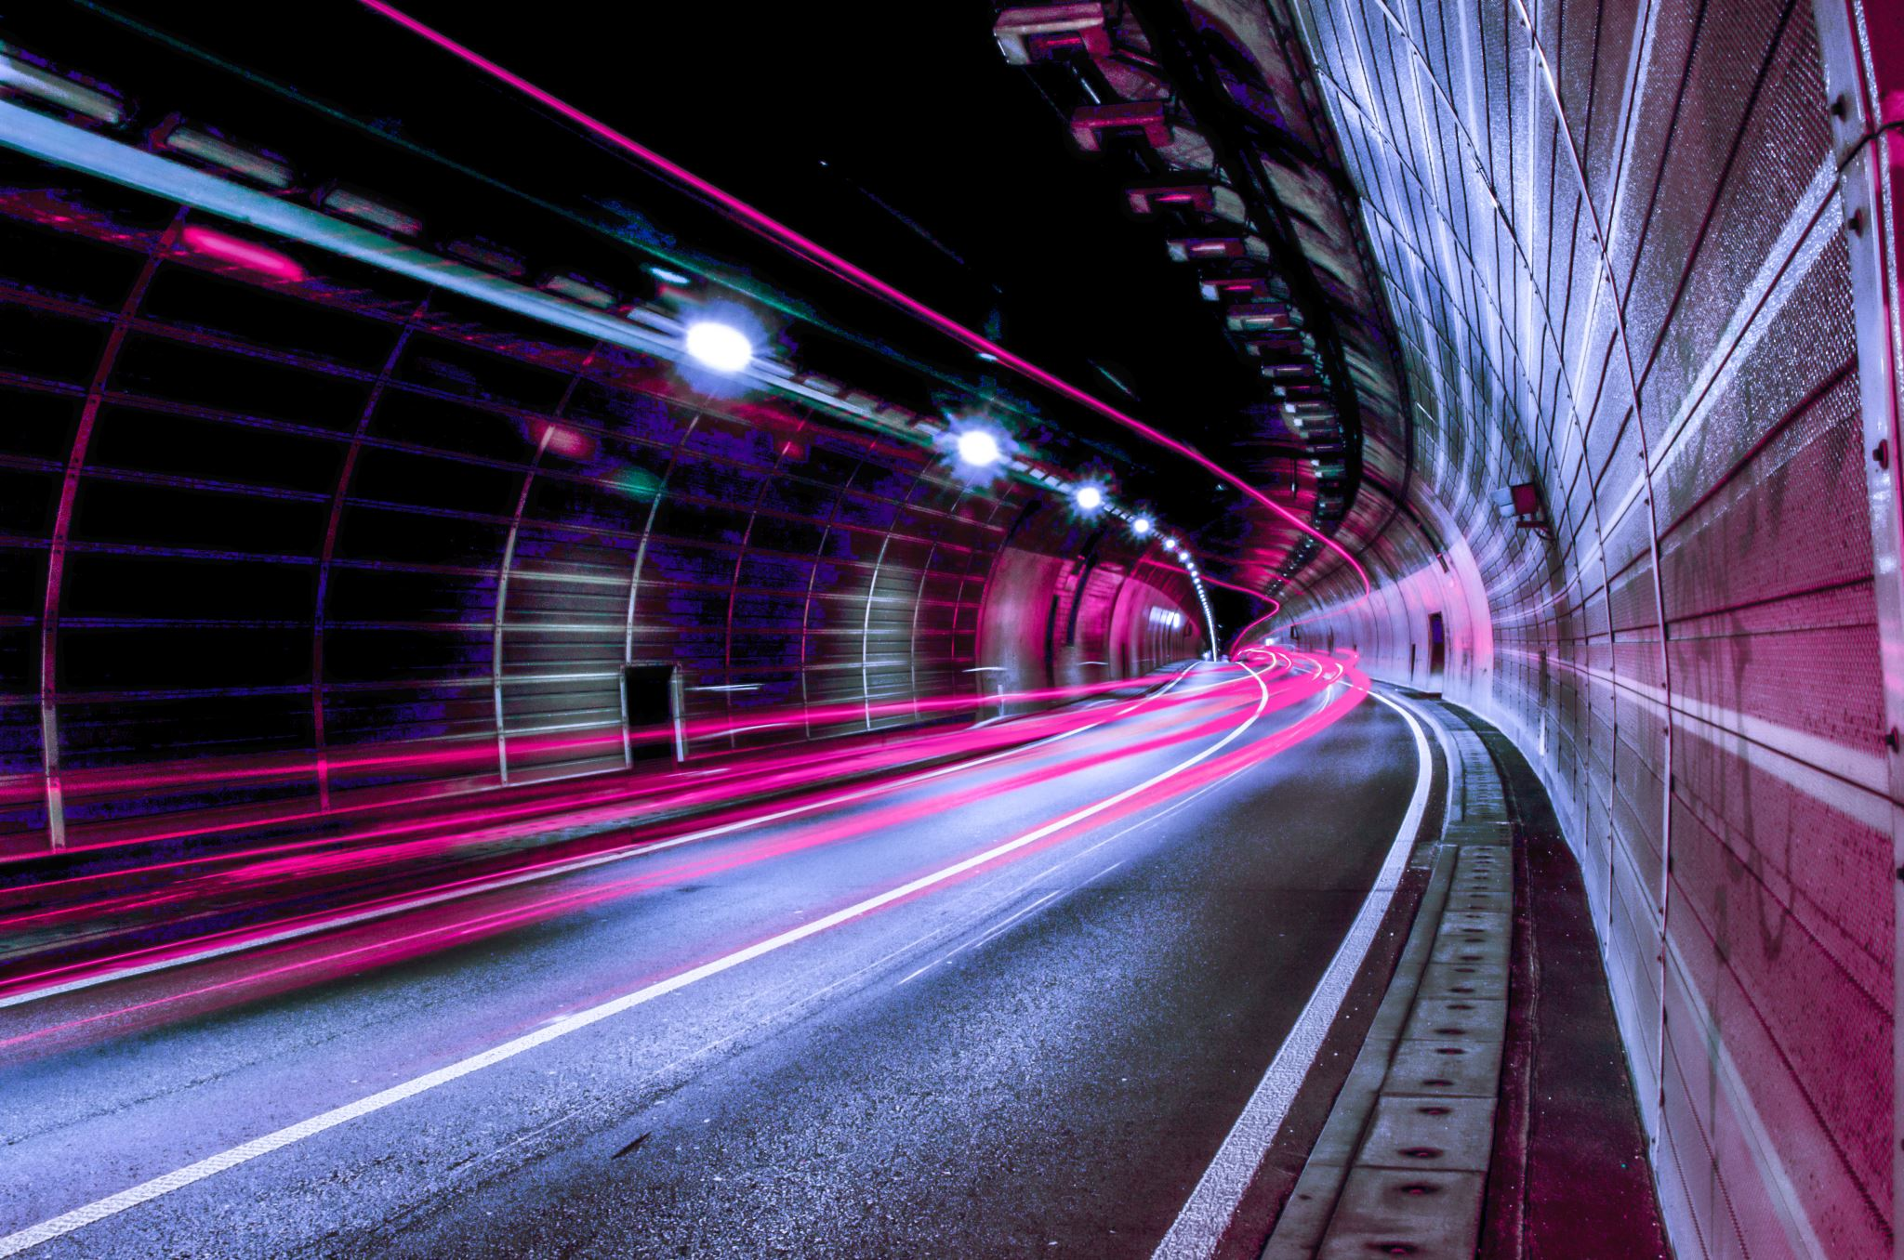
Exploring for potential New Hotel venues in Tokyo Districts

Slide 2
Business Problem
This report focusses on the issue of where to open a new hotel in a city like Tokyo, once one has decided to go ahead. Let’s imagine the Tata Subsidiary Tata Hotels willing to open a new luxury hotel, a first and foremost important decision will be the location for its new hotel.
Interest
While selecting the place there are key points to consider like they need to check out like where the most well-visited venues of the city are?
If in case there are already other luxury hotels which have good ratings, will it be risky to open new one near these hotels?

Slide 3
Data Preparation
Data Source
Scrapping Tokyo Districts Table from Wikipedia - https://simple.wikipedia.org/wiki/Special_wards_of_Tokyo
Data Cleaning
Using Beautiful Soap and to scarp the HTML page to acquire the details for the project , the following details will be necessary
- District Name – First 10 (Alphabetical Order)
- Size
- Population

Slide 4
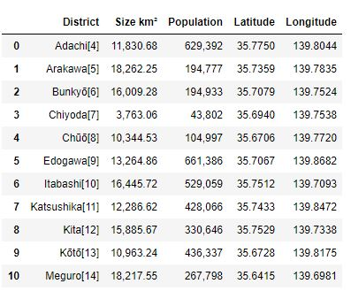
Exploratory Data Analysis
Gathering Details about the Target Districts

Slide 5
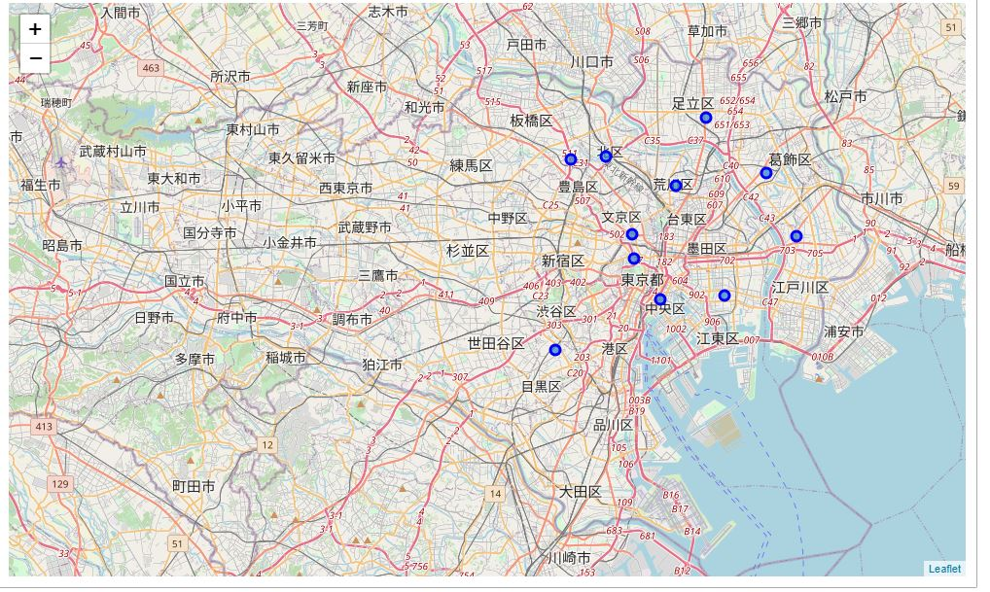
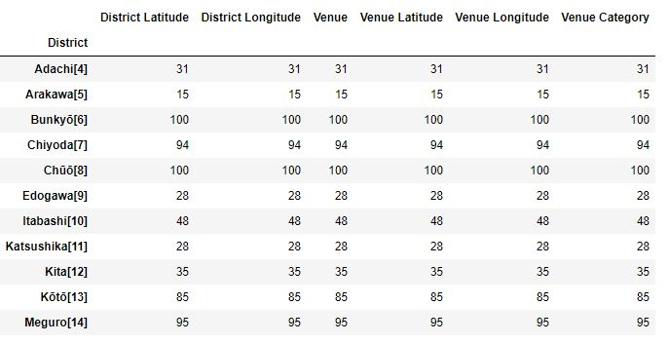
Geographical view
Foursquare API

Slide 6
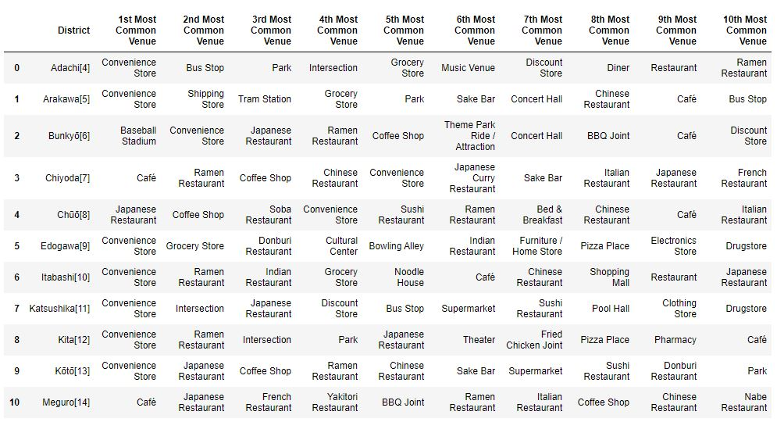
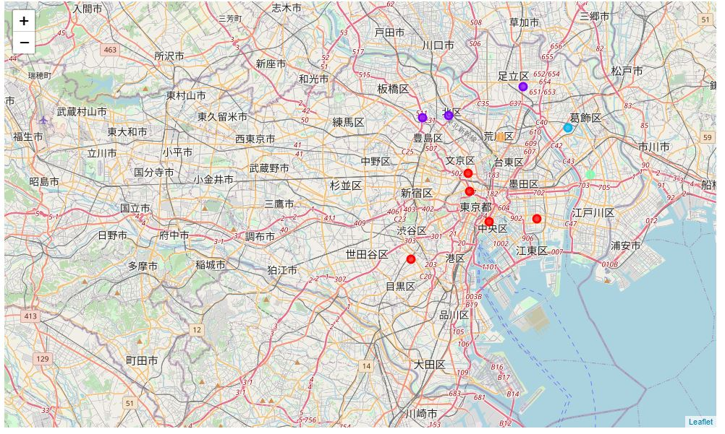
Grouped Data
Clustered View – No of Clusters - 5

Slide 7
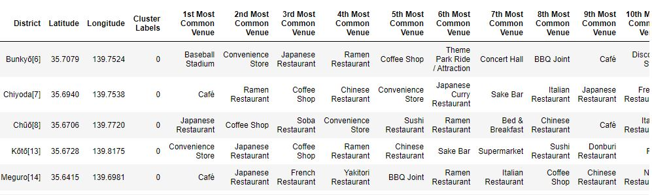
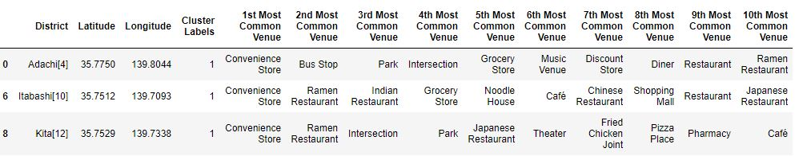
Cluster 0 – Restaurants
Cluster 1 – Restaurants & Stores

Slide 8
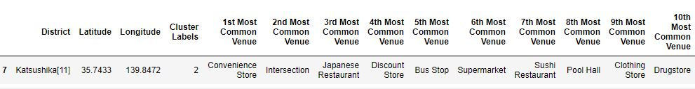
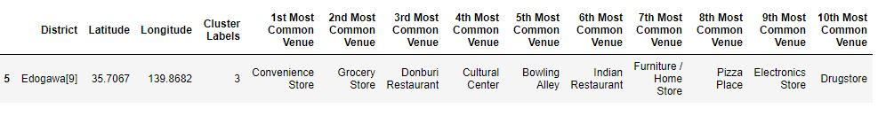
Cluster 2 – Restaurants, Stores & Public Places
Cluster 3 – Restaurants & Stores

Slide 9
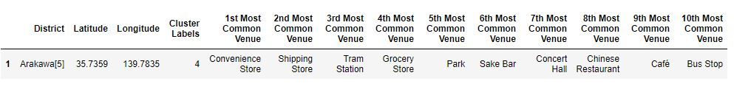
Cluster 4 – Stores, Park and Train Station

Slide 10
Results
Restaurants are clearly located only in Cluster 0 (Eastern district of Tokyo), which makes the choice of the final location very easy, in case Momentum does want to reduce risks. As for restaurants and stores for buying are very popular also in the Northern District of Tokyo in Cluster 1. Especially in Adachi district.
For Restaurants associated with Public Places, Cluster 2 has many places. Cluster 3 is similar to Cluster 2 which has many restaurants and stores together but here the shops are associated with Home items.
Cluster 4 Has minimal restaurants but has a few stores and has a bus stop and tram station.

Slide 11
Discussion
It is noticeable that Cluster 0 is the most viable clusters to build a new luxury hotel with guarantees. The proximity to a big number of Restaurants (lunch and dinner venues for guests), Coffee shops This cluster has five districts (Bunkyo, Chiyoda, Chuo, Koto, Meguro) with minimal Hotels.
Conclusion
In conclusion, this project would have had better results if there were more available data in terms of actual land pricing data within the area.
However, based on the available data, my advice to Tata Hotels would be to focus on only on Cluster 0 and within that in Bunkyo and Chiyoda Districts based on its Geographical Advantage when investing on a new luxury hotel.

Slide 12
Reference
https://simple.wikipedia.org/wiki/Special_wards_of_Tokyo - For Districts Details in Tokyo.
https://stats.stackexchange.com/questions/180883/k-means-clustering-not-working-as-expcected - Stakexchange - For K-Mean Reference.
https://www.codegrepper.com/code-examples/whatever/folium+map+python – Grepper – For Folium Maps Reference.
For project reference - “The Battle of Neighbourhoods” – Rdelhot – GitHub.

